Slide 1
Activity life cycle
Android

Slide 2
WHAT Is activity life cycle?
nutshell.live
It is a set of predefined states in which an activity can be
[create, start, pause, resume, stop, restart, destroy]
The 7 lifecycle method of Activity describes how activity will behave at different states.
As a user navigates through the app, Activity instances in your app transition through different stages in their life-cycle.
The Activity class provides a number of callbacks that allow the activity to know that a state has changed

Slide 3
Activity life cycle
Nutshell.live
onCreate( );
when the activity is first created.
onStart( );
when the activity becomes visible to the user
onPause( );
when the current activity is being paused
onResume( );
when the user starts interacting with the application
onStop( );
when the activity is no longer visible
onRestart( );
when the activity restarts after stopping it
onDestory( );
before the activity is destroyed by the system

Slide 4
Nutshell.live
Launched
onCreate( )
onRestart( )
onStart( )
onResume( )
Activity Running
onPause( )
onStop( )
onDestory( )
End

Slide 5
nutshell.live
Android development

Slide 6
Let’s do it practically

Slide 7
nutshell.live
Android development

Slide 8
Handlers
Android

Slide 9
Nutshell.live
Private Boolean isRunning;
Private int seconds;
00:00:00
onClick( )
isRunning = true;
Start
onClick( )
isRunning = false;
Stop
Reset
onClick( )
isRunning = false;
seconds = 0;

Slide 10
Text
Fun

Slide 11
Post Handler
Nutshell.live
You should use handler.post( ) whenever you want to do operations on the UI thread
Ex. Changing textView text or color or any other UI related stuff.
So let's say you want to change a textView's text in the callback. Because the callback is not running on the UI thread, you should use handler.post( ).
In Android, as in many other UI frameworks, UI elements (widgets) can be only modified from UI thread.

Slide 12
Post Handler
Nutshell.live
Syntax
Handler mHandler = new Handler();
mHandler.post(new Runnable() {
@Override
public void run () {
}
});

Slide 13
Post delay handler
Text
It’s similar to Handler.post( )
The speciality is we can execute a code block after a specific time i.e. adding delay
Syntax:
handler.postDelay(new Runnable, delayInMili);

Slide 14
Post delay Handler
Nutshell.live
Syntax
Handler mHandler = new Handler();
mHandler.postDelayed(new Runnable() {
@Override
public void run () {
}
}, 1000); // 1 second = 1000 milliseconds;

Slide 15
nutshell.live
Android development

Slide 16
Views part-1
Android

Slide 17
Three important views
Nutshell.live
Relative
Linear
Grid

Slide 18

Relative view
Nutshell.live
Relative
In relative layout widgets are positioned relative to other widgets [views and widgets can be use interchangeably]
You can choose to position a imageView at the top, an editText below an imageView, a button to the right side of the editText, etc.
We are assigning the position values of a view relative to other views or to the parent view
Message
Send

Slide 19
Linear view
Nutshell.live
A linear view displays widgets next to each other either vertically or horizontally
If orientation is vertical, widgets will be arranged in a single column
If orientation is horizontal, widgets will be arranged in a single row
Message
Send

Slide 20
Relative view
Nutshell.live
How to positioning views as per parent view?
android:layout_alignParentBottom | Aligns the bottom edge of the view to the bottom edge of the parent.
android:layout_alignParentLeft | Aligns the left edge of the view to the left edge of the parent.
android:layout_alignParentRight | Aligns the right edge of the view to the right edge of the parent.
android:layout_alignParentTop | Aligns the top edge of the view to the top edge of the parent.
android:layout_centerInParent | Centers the view horizontally and vertically in the parent
android:layout_centerHorizontal | Centers the view horizontally in the parent.
android:layout_centerVertical | Centers the view Vertically in the parent.

Slide 21
Text
Video Name
12951205
535 likes

Slide 22
Grid view
Nutshell.live
It divides a screen into grid of rows, columns, and cells
You have to specify where your widget should be present
You have to specify how much column or row span it requires
Message
Send

Slide 23
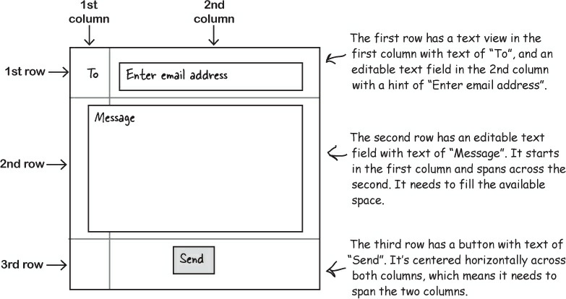

Slide 24
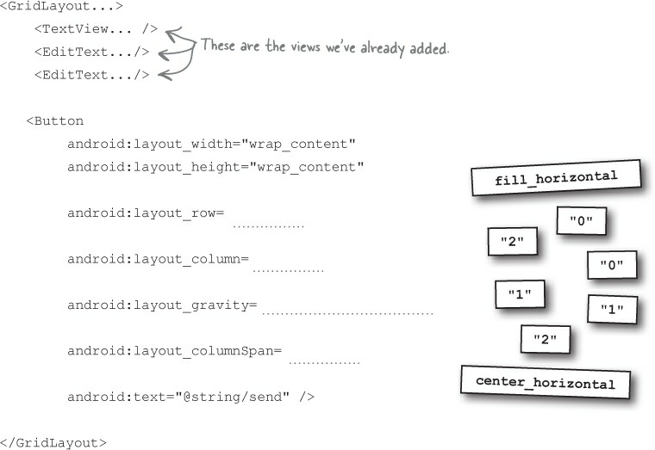

Slide 25
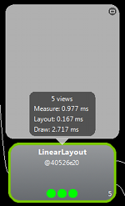
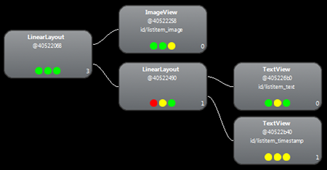
More Complexity →Example of Nested LinearLayouts
Here have First LinearLayout (vertical) that contains ImageView and then another LinearLayout (itself has 2 TextViews)
ImageView
2 TextViews

Slide 26
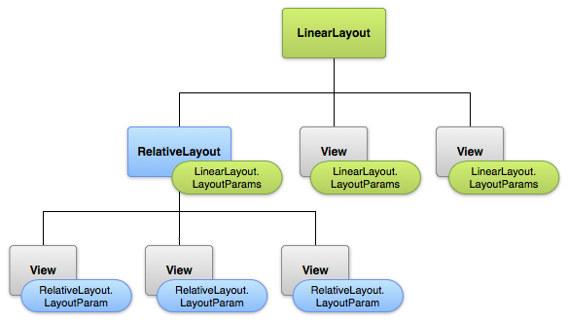
You can nest Any kind of Layouts –like here
you can have a ViewGroup (another Layout) inside as a member of the LinearLayout to make a more COMPLEX interface

Slide 27
Thank You
Geniobits - In A Nutshell
Contact us:
Web - geniobits.com
Email - contact@geniobits.com
Mobile - +91 7030089659

